Slide 1


Unit 3: Lesson 9 Taking a break

Slide 2
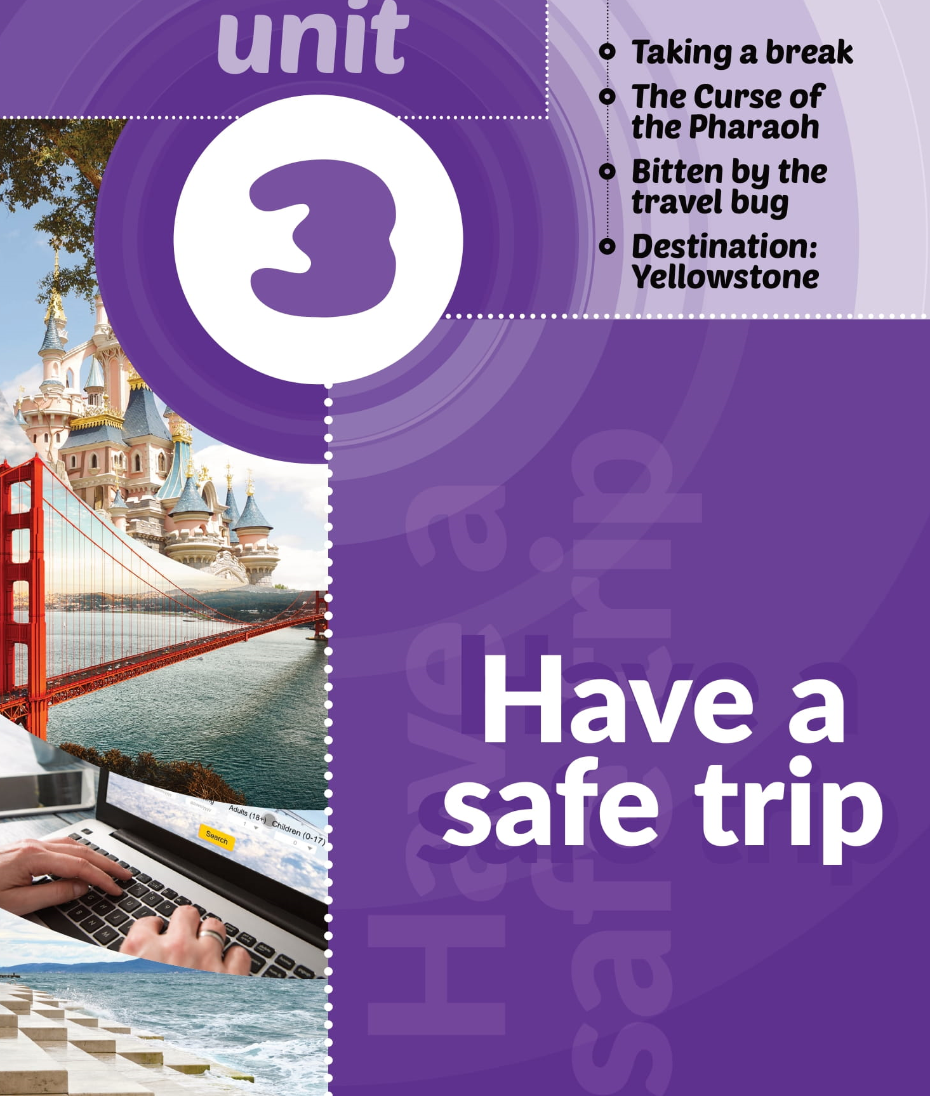

Slide 3
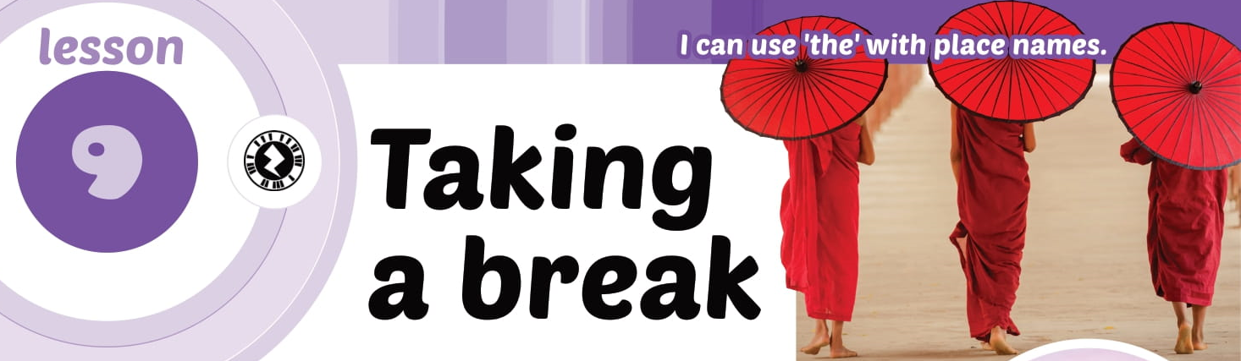

Slide 4
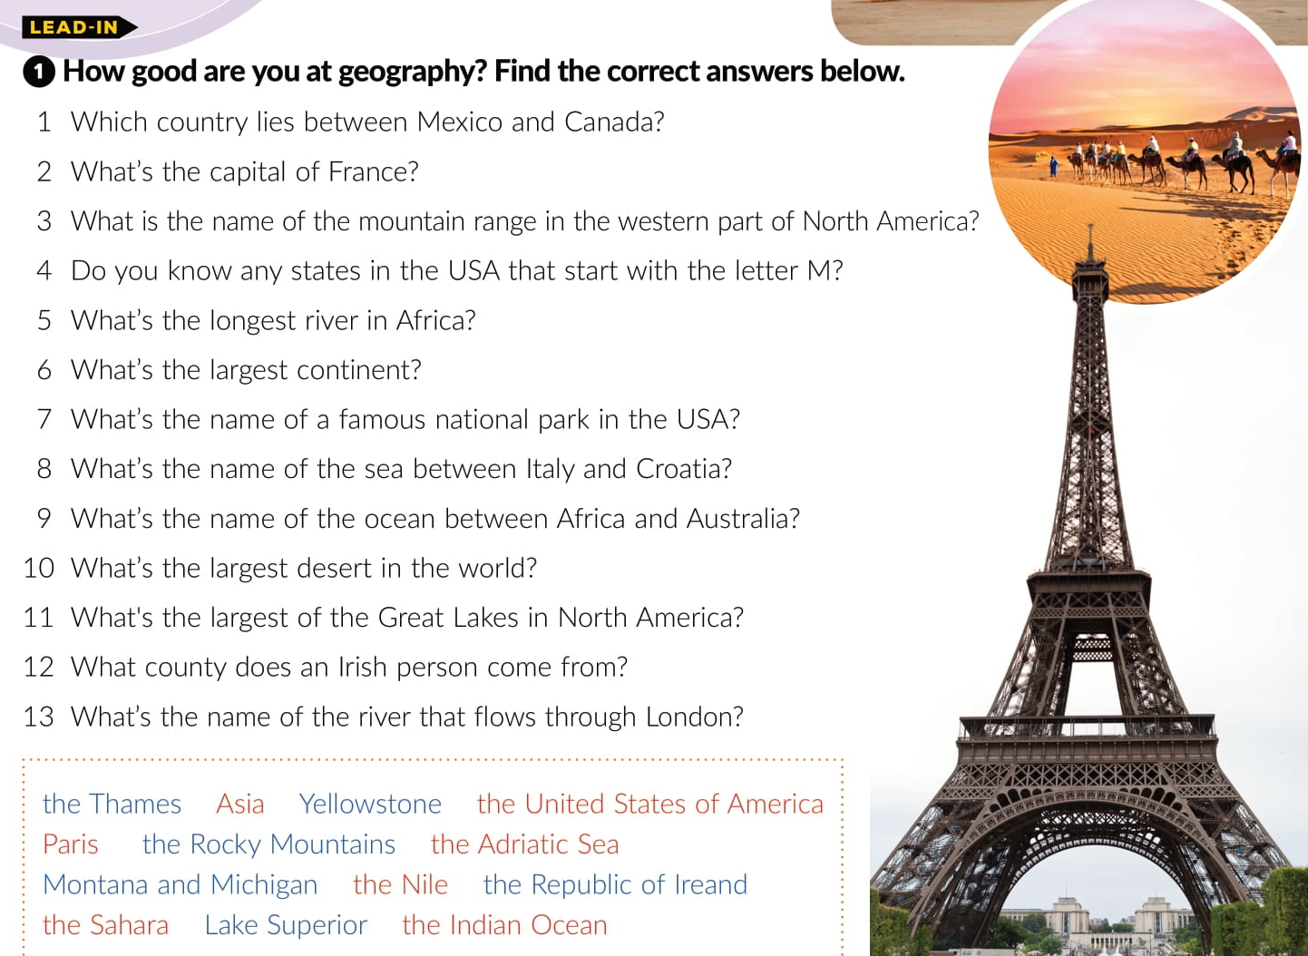
The United States of America
Paris
The Rocky Mountains
The Nile
Montana and Michigan
Asia
Yellowstone
The Adriatic Sea
The Indian Ocean
The Sahara
Lake Superior
the Republic of Ireland
The Thames

Slide 5
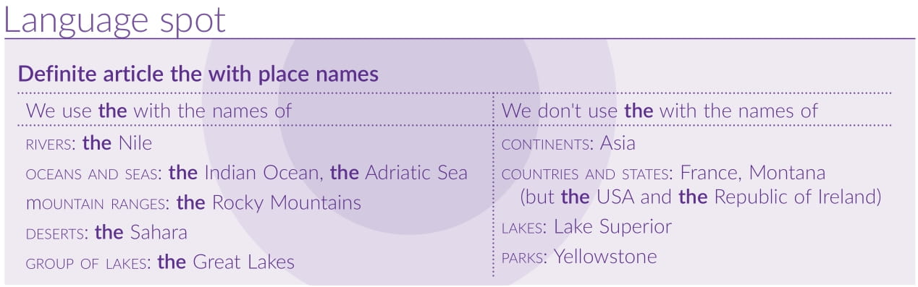

Slide 6
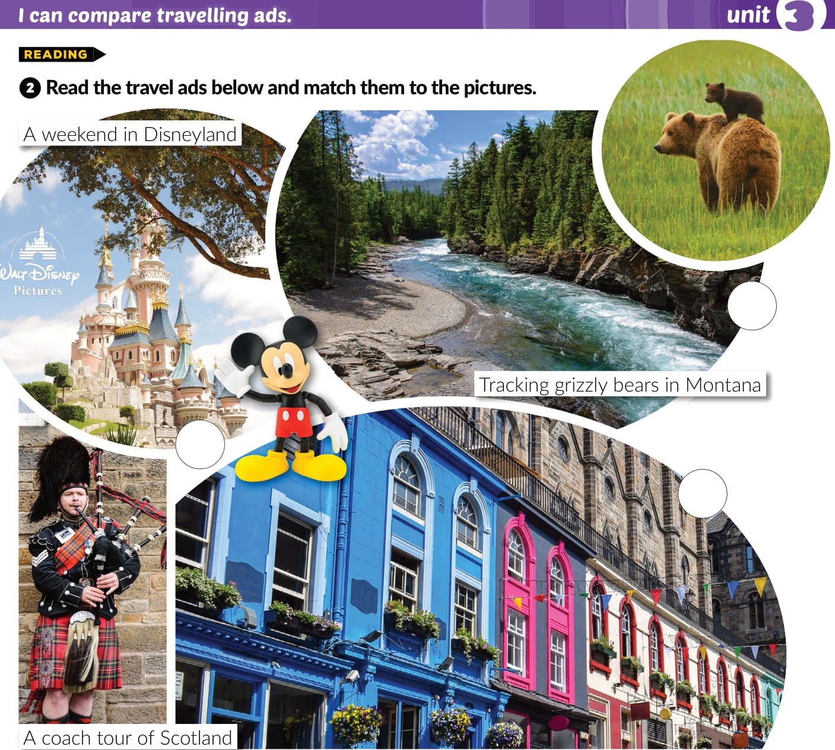
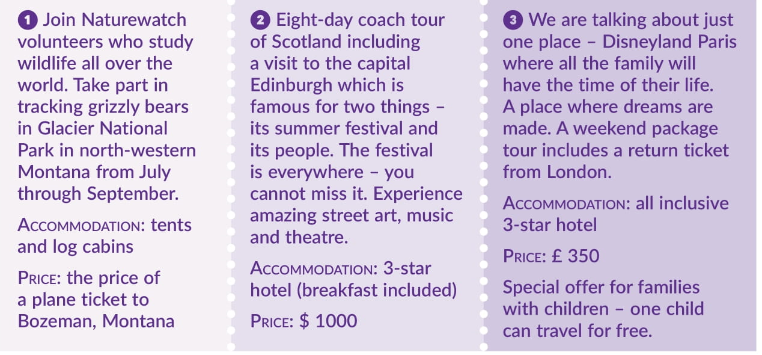
1
3
2

Slide 7
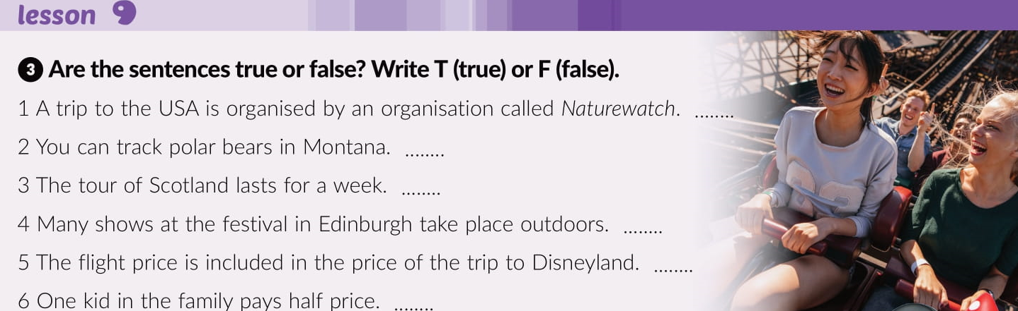
T
F
F
T
T
F

Slide 8
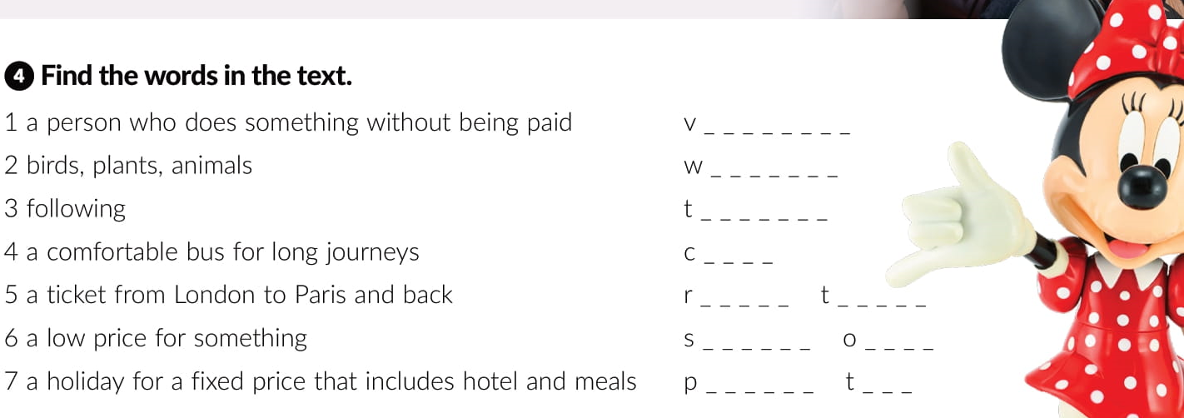
o l u n t e e r
i l d l i f e
r a c k i n g
o a c h
e t u r n
i c k e t
p e c i a l
f f e r
a c k a g e
o u r

Slide 9

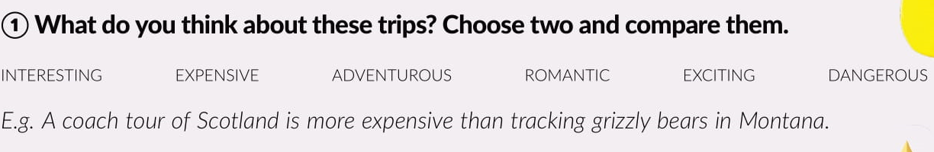
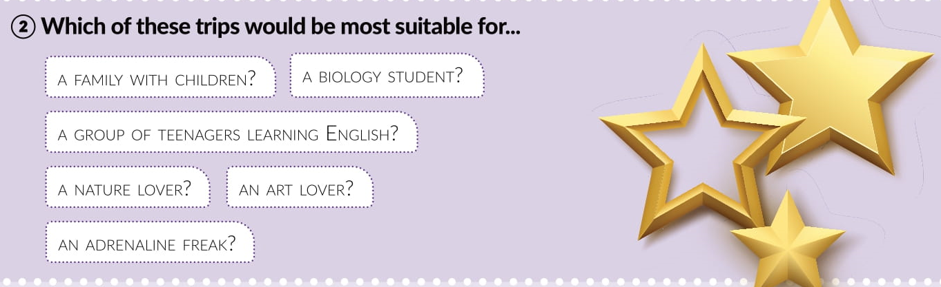


Slide 10


F
F
F

Slide 11
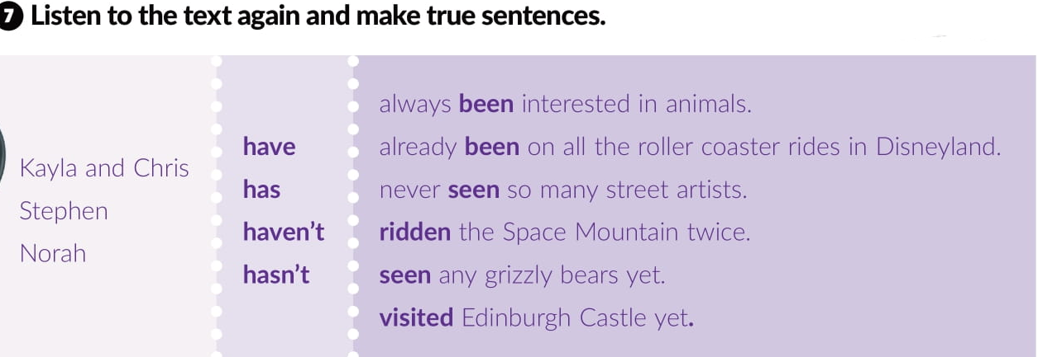

Slide 12
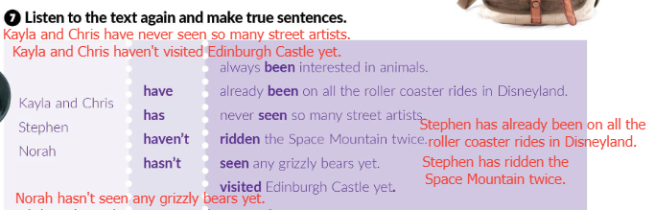
Check!

Slide 13
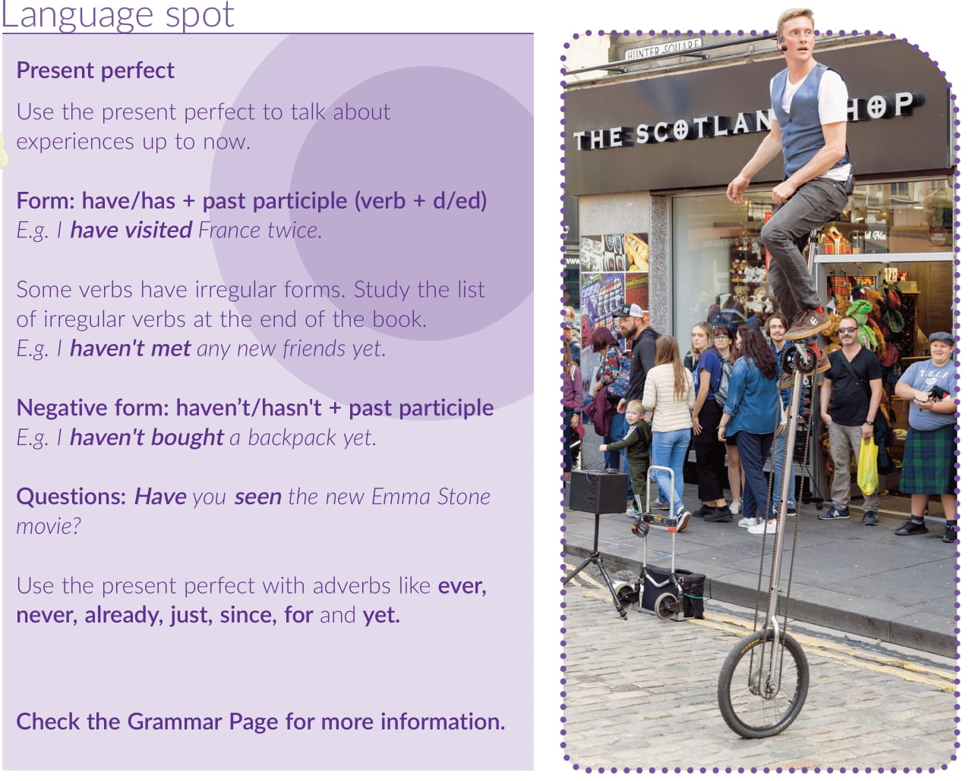

Slide 14
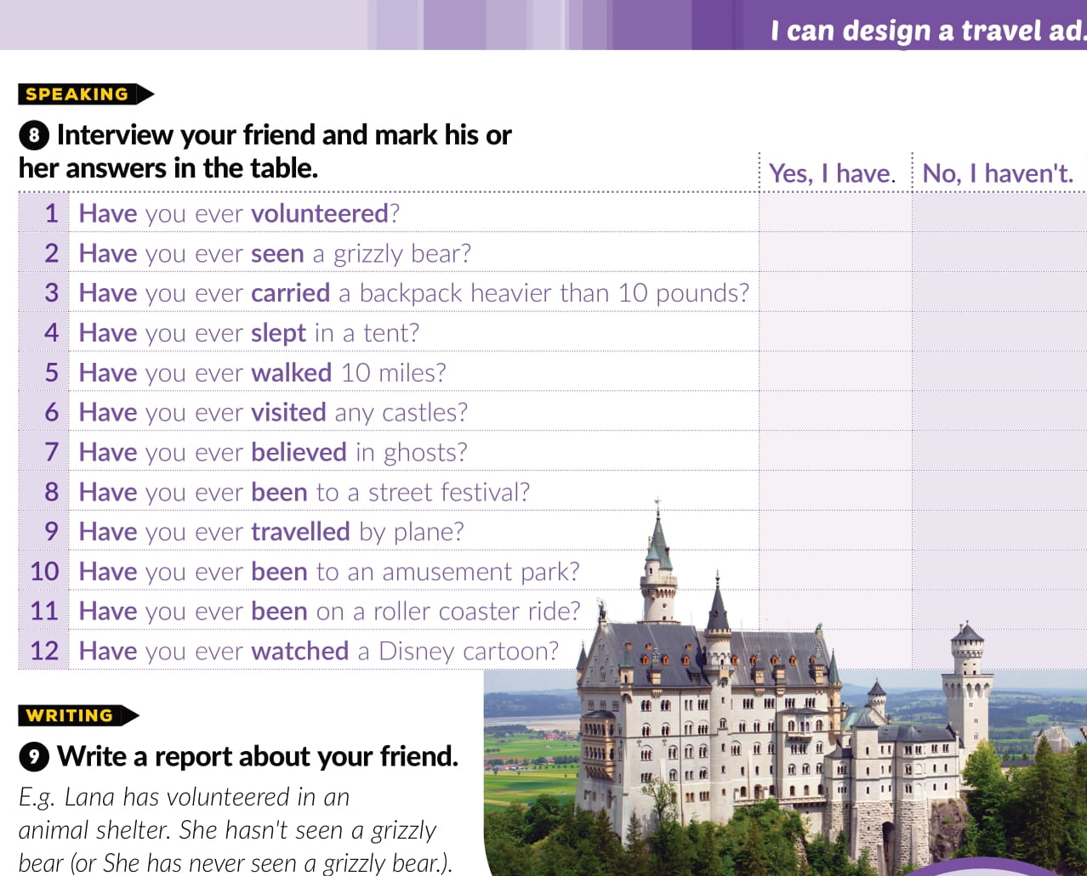

Slide 15
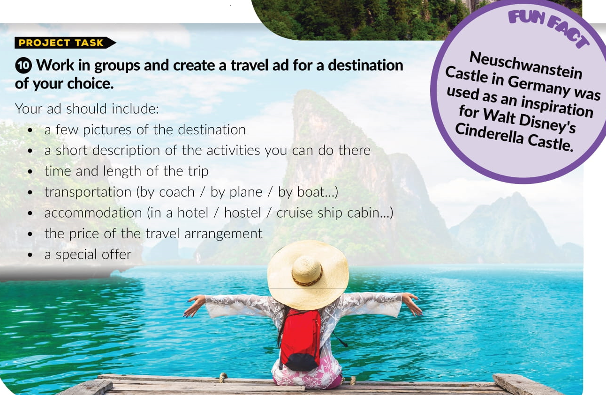

Slide 16
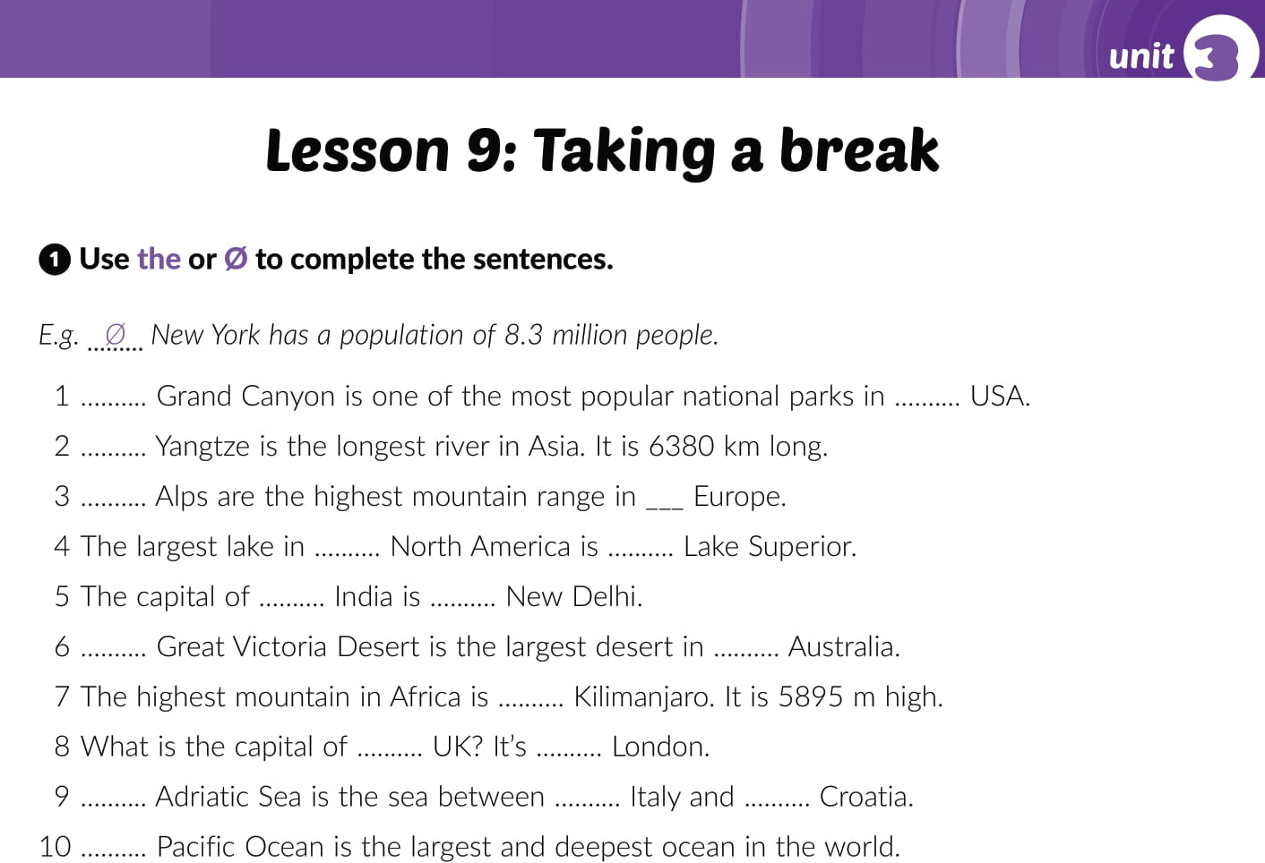
Workbook, p. 37
Ø
the
The
The
Ø
Ø
Ø
Ø
Ø
The
Ø
Ø
the
Ø
The
Ø
Ø
The

Slide 17
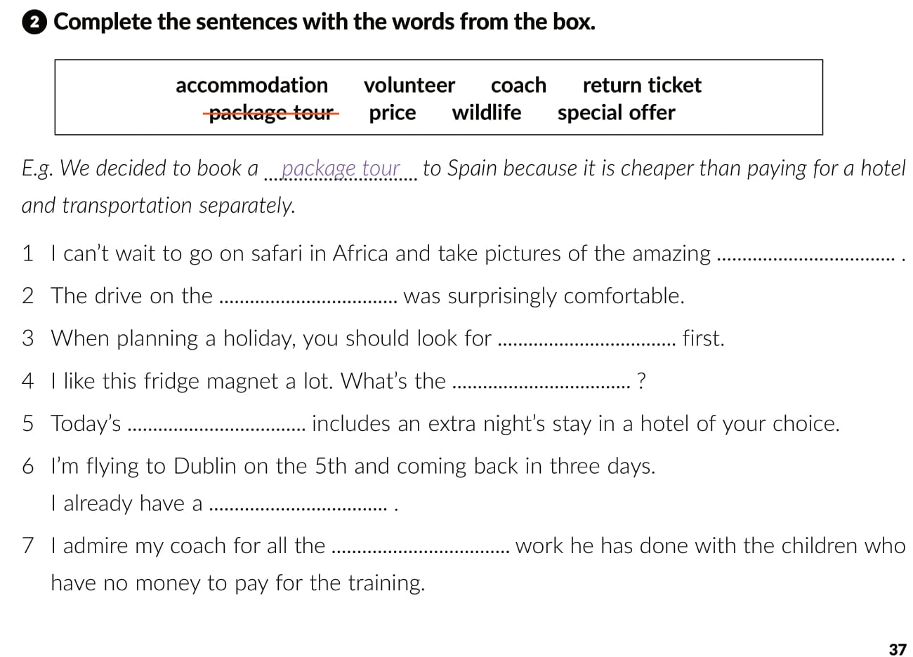
wildlife
coach
accommodation
price
special offer
return ticket
volunteer

Slide 18
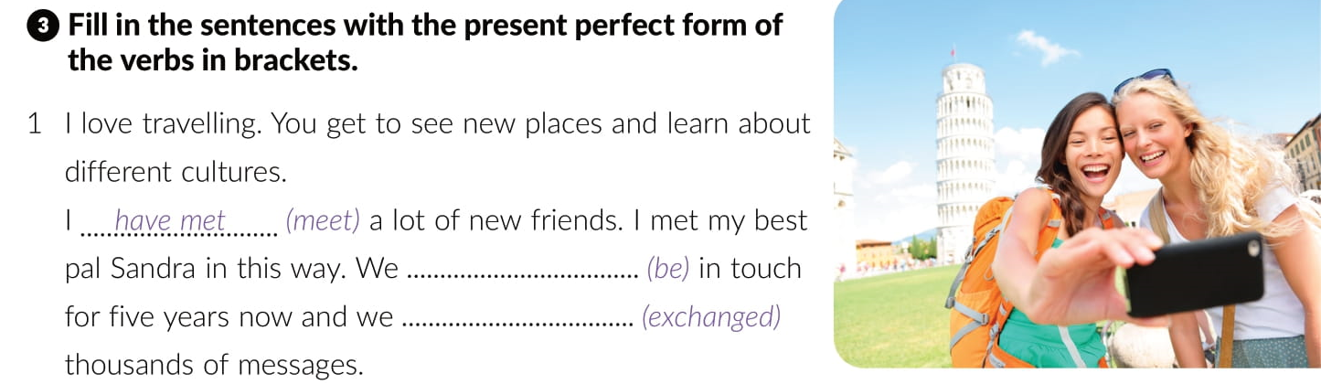
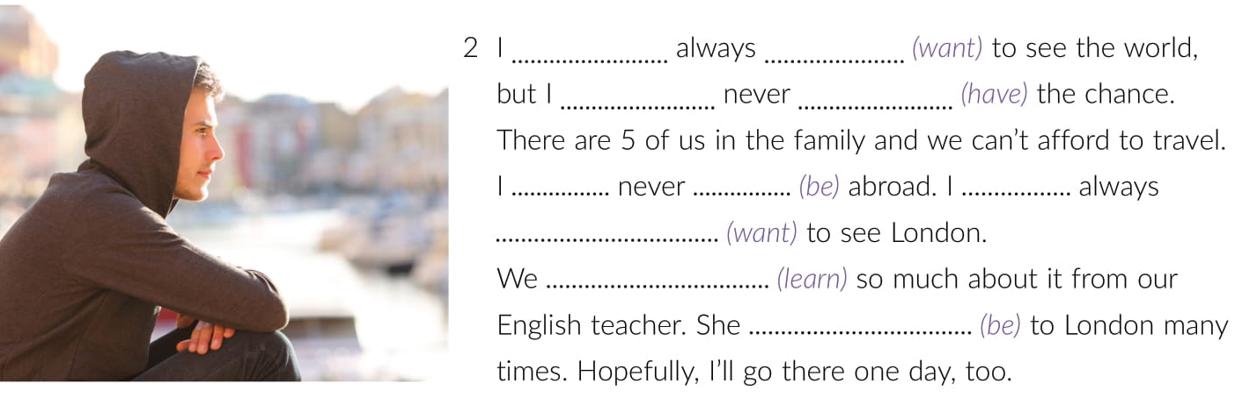
have been
have exchanged
have
wanted
have
had
have
been
have
wanted
have learned
has been

Slide 19
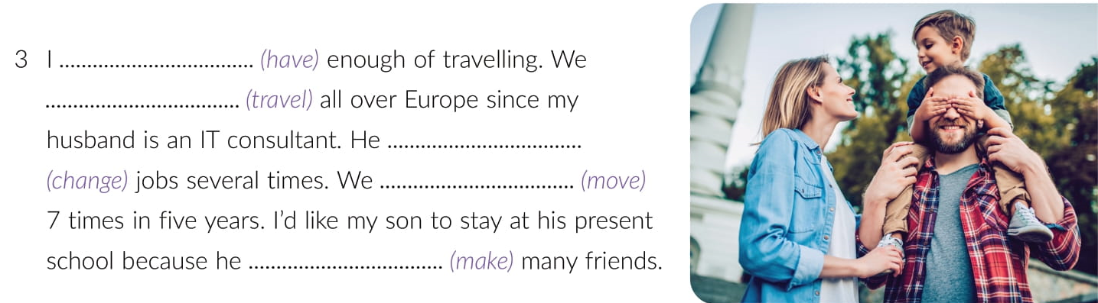
have had
have travelled
has changed
have moved
has made

Slide 20
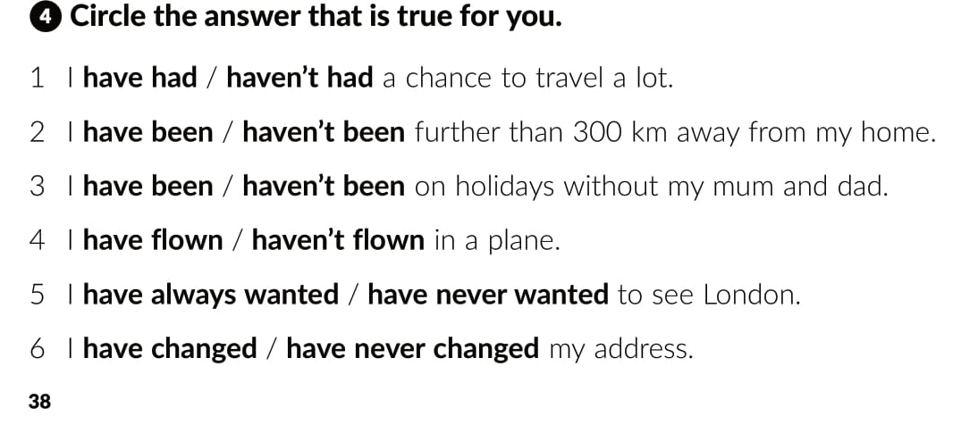

Slide 21
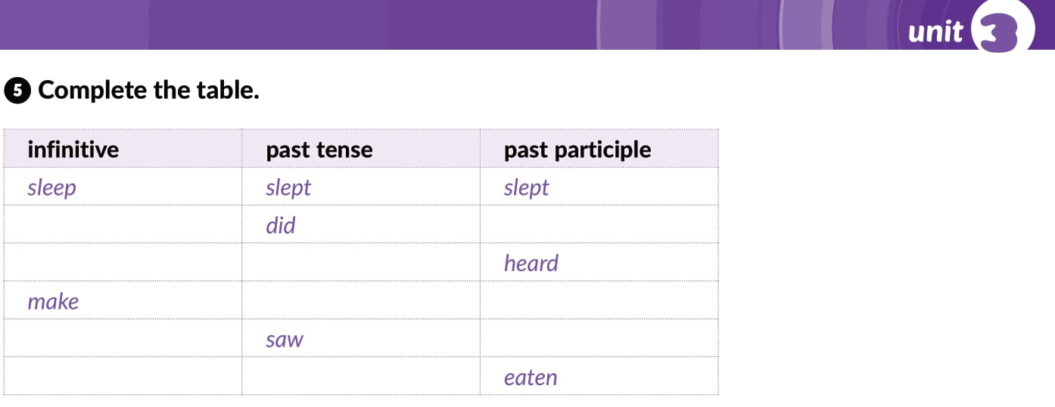
do
done
hear
heard
made
made
see
seen
eat
ate

Slide 22
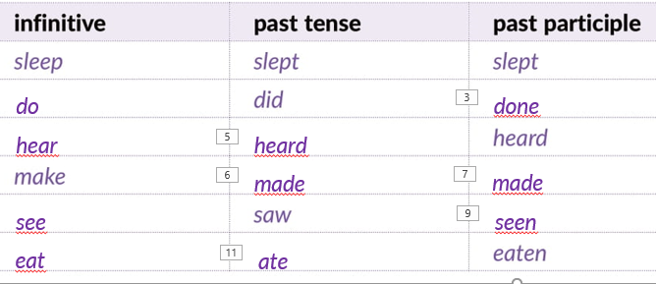
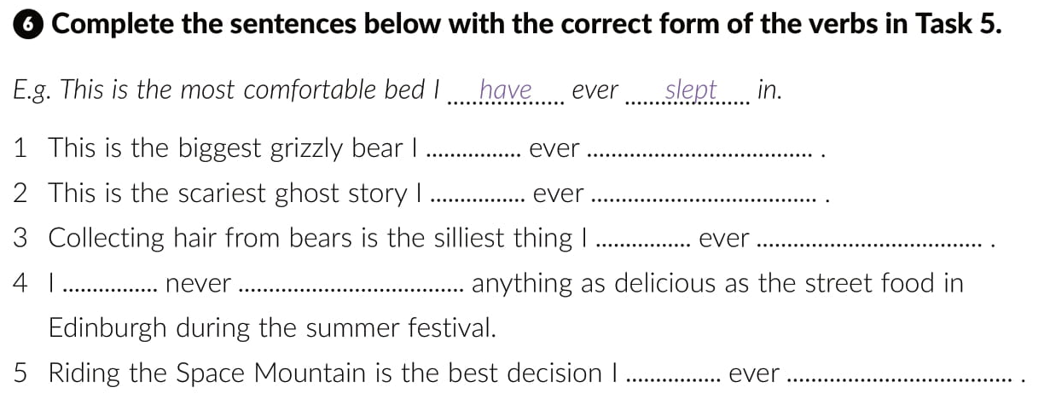
have
seen
have
heard
heard
done
have
eaten
have
made

Slide 23
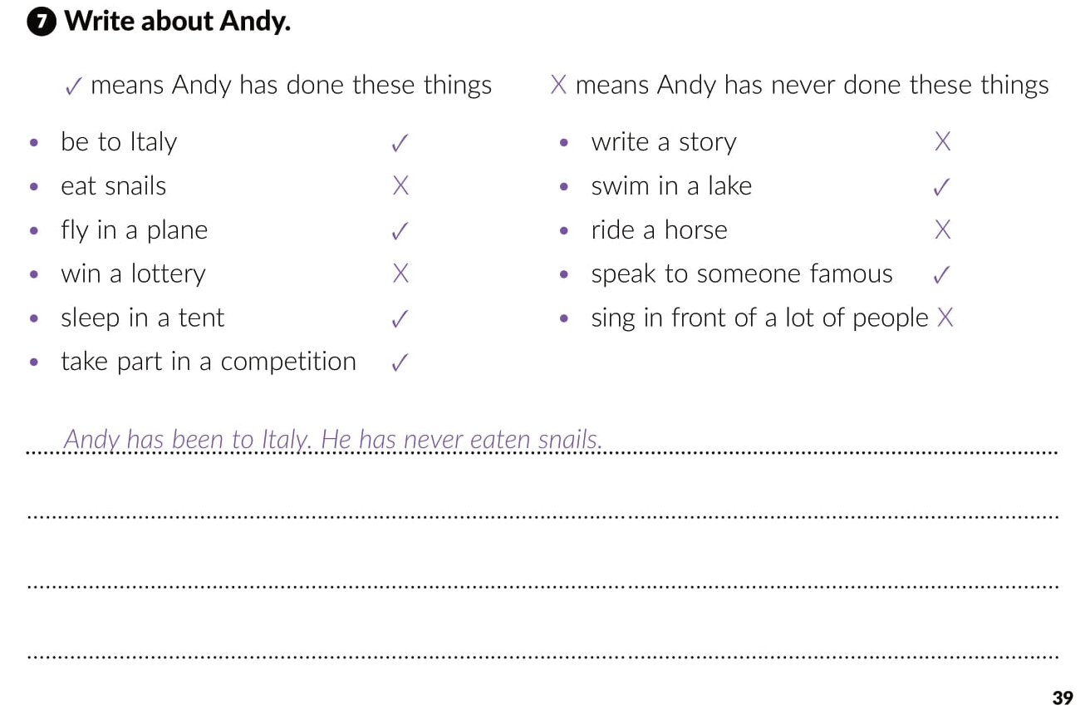
He has flown in a plane.
He has never won lottery.
He has slept in a tent and taken part in a competition.
Andy has never written a story.
He has swum in a lake.
He has never ridden a horse.
He has spoken to someone famous.
He has never sung in front of a lot of people.

Slide 24
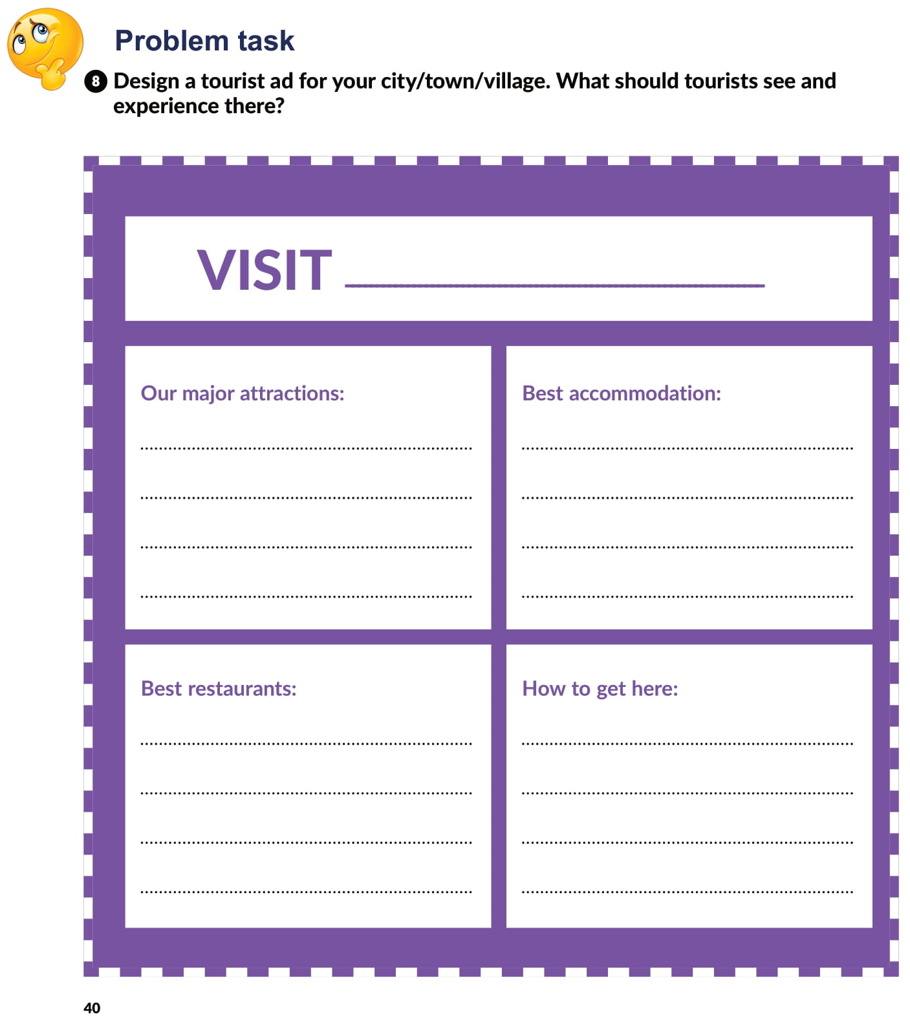

Slide 25

PLAY AND LEARN
Lesson 9 Taking a break | Way to go 4 (e-sfera.hr)

